Slide 1


Self-Driving Car Code Explanation
Ministry of Higher Education
Pyramids High Institute (PHI) for Engineering and Technology
Electronics and Communication Engineering Department
Under Supervision
Dr. Gamal Elshiekh
Dr. Esraa Elrefaey
Team Members
Abdelrahman Shrief
Asmaa Mohamed
Sondos Reda
Mohammed Hossam
Mohammed Alaa
Mohammed Nageh
Mahmoud Gaballah
Moamen Mourad

Slide 2

Team members
Abdelrahman Sherif Ali THE LEADER
Asmaa Mohamed Abdelhamed
Moamen Ahmed Mourad
Mohammed Alaa
Mahmod Mohamed
Mohamed Nageh
Sondos Reda Ghareeb
Mohamed Hossam

Slide 3

The project idea
Control the car across the web site via the ESP8266 throughout the MPU6050 readings

Slide 4
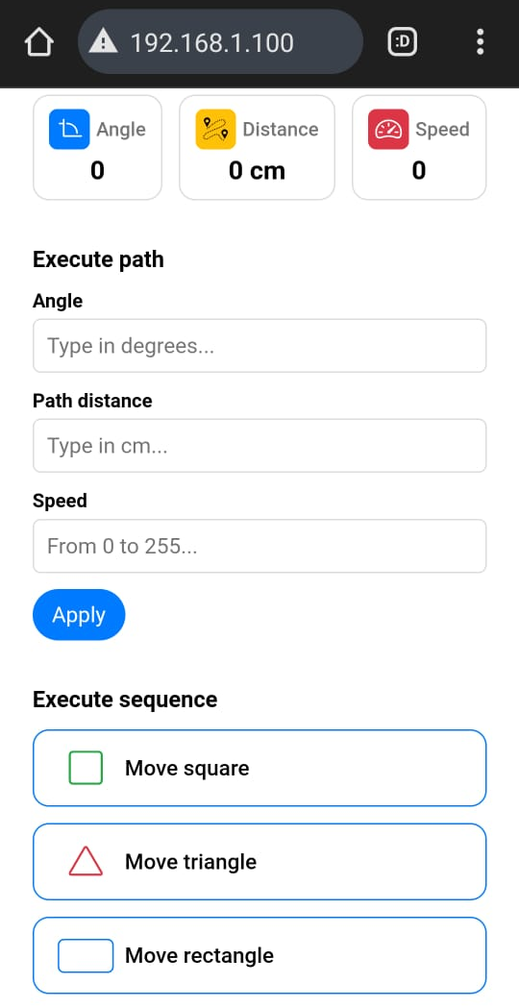



Slide 7
The connection between the web site & the car
for controlling an autonomous car via an ESP8266 microcontroller. The system allows users to remotely control the car and view real-time data on its movements and actions by connecting to the ESP network which called Autonomous Car and password is auto2244 ,then can go to 192.168.1.100 which operates as the Server Side.

Slide 8
Present the car

Slide 9

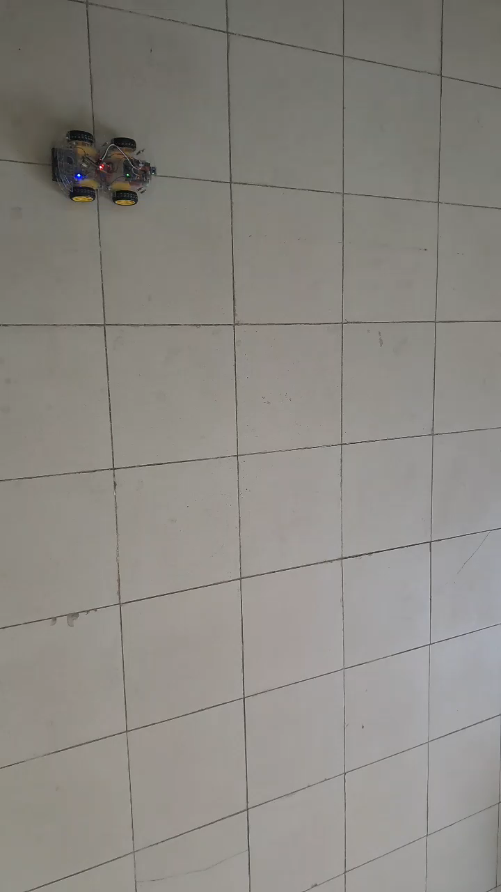

Slide 10
Outlines
Functions’ Algorithms
Mpu6050 Angles Calculations
Movements of the car
Execute Sequence
Execute Path
Go To (x,y) Coordinates
Distance Calculations

Slide 11
Mpu6050 Angles Calculations
Calculate the error:
Purpose: Calibrates the IMU sensors to reduce error in readings.
Benefits: Improves the accuracy of sensor data, enhancing navigation performance.
2. Update readings:
Purpose: Obtains and updates the latest readings from the MPU.
Benefits: Ensures the robot has the most current sensor data for decision-making.
function calculate_IMU_error():
for i from 0 to 200
read sensor data
accumulate errors
average errors to reduce drift
function update_mpu_readings():
initiate I2C transmission with MPU
request data
read accelerometer and gyroscope values

Slide 12
Movements of the car
Purpose: Activates motors to move the robot forward or left or right
Benefits: Provides basic forward, left , right movement functionality.
function instantStop():
set motorR1 HIGH
set motorR2 HIGH
set motorL1 HIGH
set motorL2 HIGH
function moveForward()
set motorR1 LOW
set motorR2 HIGH
set motorL1 LOW
set motorL2 HIGH
function moveRight():
set motorR1 HIGH
set motorR2 LOW
set motorL1 LOW
set motorL2 HIGH
function moveLeft():
set motorR1 LOW
set motorR2 HIGH
set motorL1 HIGH
set motorL2 LOW

Slide 13
Execute path
Purpose: Calculates and executes the path based on the initial angle and distance.
Benefits: Enables precise navigation by adjusting the robot's movements based on sensor feedback.
function SetCarPath(initial_angle,path_distance, speed):
turnCar(initial_angle)
moveForward()
while distance < path_distance:
adjust motor speeds based on sensor feedback
if obstacle detected
stop and recalculate path

Slide 14
Execute Sequence
Purpose: Moves the robot in a square pattern.
Benefits: Demonstrates the robot's ability to execute complex shapes.
function moveSquare(length, speed):
for i from 1 to 4:
SetCarPath(yaw, length, speed)
turnCar(yaw - 90, speedTurn)
Purpose: Moves the robot in a triangular pattern.
Benefits: Shows versatility in movement patterns.
function moveTriangle(length, speed):
for i from 1 to 3:
SetCarPath(yaw, length, speed)
turnCar(yaw - 120, speedTurn)
Purpose: Moves the robot in a rectangular pattern.
Benefits: Further demonstrates the robot's capability to perform complex movements.
function moveRectangle(length, width, speed):
SetCarPath(yaw, length, speed)
SetCarPath(yaw - 90, width, speed)
SetCarPath(yaw, length, speed)
SetCarPath(yaw - 90, width, speed)

Slide 15
Execute Sequence
Purpose: Executes predefined movement sequences based on the input string.
Benefits: Simplifies complex movements into manageable commands for the robot.
function performSequence(str):
if str == "moveSquare":
moveSquare(squareLength, squareSpeed)
if str == "moveRectangle":
moveRectangle(rectangleLength, rectangleWidth, rectangleSpeed)
if str == "moveTriangle":
moveTriangle(triangleLength, triangleSpeed)

Slide 16
Go To (x,y) Coordinates
Purpose: move a vehicle to a specified location (XD, YD) with a given speed. It calculates the necessary angle and distance, sets the car's path, and turns the car back to its initial angle after moving to the destination.
Benefits:
function moveToLocation(XD, YD, speed)
Init_Angle = yaw
if XD == 0 and YD == 0
return
if XD == 0 and YD > 0
SetCarPath(0, abs(YD), speed)
turnCar(Init_Angle, speedTurn)
return
if XD == 0 and YD < 0
SetCarPath(180, abs(YD), speed)
turnCar(Init_Angle, speedTurn)
return
if XD > 0 and YD == 0
SetCarPath(-90, abs(XD), speed)
turnCar(Init_Angle, speedTurn)
return
if XD < 0 and YD == 0
SetCarPath(90, abs(XD), speed)
turnCar(Init_Angle, speedTurn)
return
angle = atan2(XD, YD) * 180 / PI
diameter_squared = abs(XD) * abs(XD) + abs(YD) * abs(YD)
diameter = sqrt(diameter_squared)
SetCarPath(-angle, diameter, speed)
turnCar(Init_Angle, speedTurn)

Slide 17
Prototype update
Y-axis
0
1
2
3
4
5
6
7
8
9
0
1
2
3
4
5
6
7
8
9
X-axis

Slide 18
conclusion

